Slide 1
Think of a Meaningful Learning Experience to Share Why was it meaningful?
While you wait
Reconciling Humanity with the Planet by creating the university of the future

Slide 2
Pair up with somebody and share your experience.
Share
Share
2 min max each!
Reconciling Humanity with the Planet by creating the university of the future

Slide 3
Now tell the other person their story back to them, as if you are them (in the first person)
Share
Empathise
2.5 min max each!
Reconciling Humanity with the Planet by creating the university of the future

Slide 4
How did the exercise make you feel? What did you notice about yourself?
Share
Discuss
Reconciling Humanity with the Planet by creating the university of the future

Slide 5
Transdisciplinary Teambuilding
12 November 2020
11:00 IST/ 12:00 CET
Recording session

Slide 6
Agenda
Icebreaker
Introduction and rationale
Introductions within groups
Transdisciplinarity
Synchronicity Activity
Epistemological Perspectives
Charter
Conclusion
Reconciling Humanity with the Planet by creating the university of the future

Slide 7
CHARM-EU Transdisciplinarity (LERU)
Multidisciplinarity: sequential analysis of a problem by disciplinary experts with few interactions between them.
Interdisciplinarity: growing interactions and efforts to integrate disciplinary insights with a scientific added value for the involved disciplines.
Transdisciplinarity: interactions are extended outside academia to solve problems of societal importance through integration of knowledge from different actors.

Slide 8
Plurality of definitions
1970s
1970s
1990s
1990s

Slide 9
Swiss Tradition – Swiss Academies of Arts and Science – ETH Zurich – Christian Pohl et al.
Purpose Problem Solving: Co-production of Knowledge
Three Forms of Knowledge
Step 1: Socially relevant problem field
Step 2: Within this field, identify, structure, analyse and deal with specific problems in such a way that it can: a) grasp the complexity of problems; b) take into account the diversity of life-world and scientific perceptions of problems; c) link abstract and case-specific knowledge, and d) develop knowledge and practices that promote what is perceived to be the common good.
Disciplinary contributions connected to examining a societal challenge are framed as follows:
Knowledge about what is (systems knowledge);
Knowledge about what should or should not be (target knowledge);
Knowledge about how to get from where we are to where we should be (transformation knowledge).

Slide 10
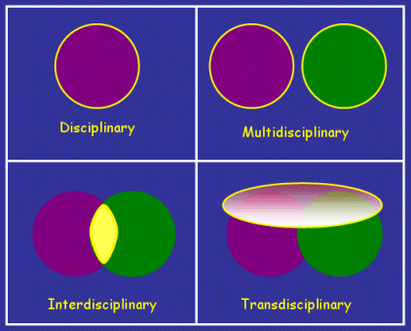
What is Transdisciplinarity to me?
Distinct from other terms such as ‘inter-disciplinary’ and ‘multi-disciplinary’ it looks beyond traditional disciplinary boundaries (including extra-academic actors) to come up with new ideas.
Combines Reflection and Action
Holistic approach to learning: Collaboration in a supercomplex world (Barnett, 2000).
Metacognition: ‘think about thinking’.
Community of Inquiry model (Pardales & Girod, 2006).

Slide 11
Towards a Transdisciplinary Perspective
Values & beliefs
Attitude
Motivation
Knowledge
Skills
Social-System
Meta-System

Slide 12
Towards a Transdisciplinary Philosophy
Social Constructivism - Educational Philosophy
Evolutionary Epistemology
Process philosophy - Whitehead and Bohm
New approaches to Science and Philosophy (e.g. phenomenology) offer alternative views of reality in terms of inter-connectivity and related-ness, participation, complexity, systems and emergence of order from chaos (development) and legitimizes the use of imagination and intuition for learning and tackling ‘wicked problems’
Notes:
A wicked problem is a problem that is difficult or impossible to solve because of incomplete, contradictory, and changing requirements that are often difficult to recognize. The use of term "wicked" here has come to denote resistance to resolution, rather than evil.[1] Moreover, because of complex interdependencies, the effort to solve one aspect of a wicked problem may reveal or create other problems. https://en.wikipedia.org/wiki/Wicked_problem

Slide 13
Towards a Transdisciplinary Perspective
Social Constructivism - Educational Philosophy
Evolutionary Epistemology
Process philosophy - Whitehead and Bohm
New approaches to Science and Philosophy (e.g. phenomenology) offer alternative views of reality in terms of inter-connectivity and related-ness, participation, complexity, systems and emergence of order from chaos (development) and legitimizes the use of imagination and intuition for learning and tackling ‘wicked problems’

Slide 14
Synchronicity
From the form you submitted prior to this workshop select (5-6) phrases related your discipline or work. Write them on the screen.
Introduce yourself to your group
1 min (total)
What interested you in CHARM-EU?
Find words that resonate or that you are curious about on other peoples’ lists
10 min

Slide 15
Synchronicity
What “Problem Spaces”/ Challenges/ Solutions might emerge from the combination of 2-3 phrases from multiple people?
5 min

Slide 16
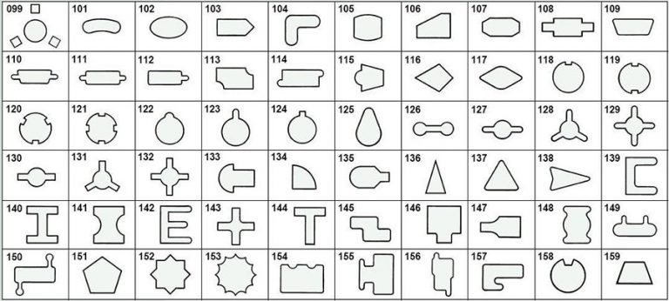
Epistemological Perspectives
Choose one “Problem Space” from before
Swap perspectives, review (2 min) (make sure there is disciplinary “distance”)
Explore the “Problem Space” from this new perspective (Role play) (1 min each)
Try to visualise the “Problem Space” and discuss how are its elements related.
https://www.unipunch.com/system-capabilities/shapes/

Slide 17
Epistemological Perspectives
Discuss
Identify synergies (1-2) and dichotomies (1-2)
How might we reconcile dichotomies?

Slide 18
Epistemological Perspectives
Moving forward, things to consider:
How might we involve more perspectives in TD work?
Engage more with the KCT Expanded Network?
This includes
Other academics
Students
Extra-academic actors from Business and Society

Slide 19
What is Transdisciplinarity?
Real solution to a real problem
science-based innovation with social and economic benefits
a common view that problems and solutions are holistic
ability to understand complexity and make judgements
Social responsibility
grasp of the whole (not just a fragment)
Finding common ground in purpose with other disciplines
What did you say and how do we look back at what you said now that the workshop is finished?
Openness to failure
avoid feeling threatened
good spirit of synthesis
creativity, relational skill
stimulating synergies, integrating knowledge
open-minded and able to learn from other disciplines
ability to assimilate other point of views of other experts
potential of transdisciplinary team mechanisms
Communication skills, negotiation skills

Slide 20
Charter?
Manifesto of Transdisciplinarity, 1994, signed by B. Nicolescu, E. Morin and L. de Freitas
Article 4:
The keystone of Transdisciplinarity is the semantic and practical unification of the meanings that traverse and lie beyond different disciplines. It presupposes an open-minded rationality by re-examining the concepts of "definition" and "objectivity." An excess of formalism, rigidity of definitions and a claim to total objectivity, entailing the exclusion of the subject, can only have a life-negating effect.

Slide 21
Jake Byrne: jake.byrne@tcd.ie
Gemma O’Sullivan: OSULLIG9@tcd.ie

