Slide 1
Technology Enhanced Learning
THE WORKSHOP
4th of February 2021

Slide 2
GOALS OF THE WORKSHOP
To inform each other on what technology might be a useful addition to your CHARM-EU module
To inform KCT’s about other consideration when selecting tools (I.e., digital accessibility)
To help us (support) decide on what technology we should support and prepare for the CHARM-EU master’s pilot
To inform KCT members who they can contact for further information and guidance and how to request tools and / or technology.

Slide 3
SCHEDULE
What kind of tech user are you? Wooclap voting (10 minutes)
Discovering Strengths, Weaknesses, Opportunities and Threads of Technology Enhanced Learning using Miro (10 minutes)
Recap and information on what support will be available to implement Technology Enhanced Learning (8 minutes)
KCT pitches on technology enhanced learning plans (35 minutes)
Recap and information on requesting new technology and digital accessibility (20 minutes)
Closing
Notes:
Go through schedule – inform that it’s an interactive workshop and that people can raise virtual hands to interrupt / ask questions. Inform that we plan on recording the last half of the workshop for sharing within CHARM-EU. Schedule point 4.

Slide 4
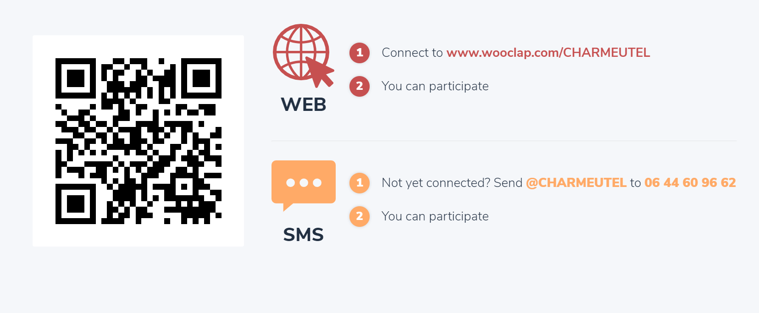
LET'S PARTECIPATE! Connect via computer or smartphone

Slide 5
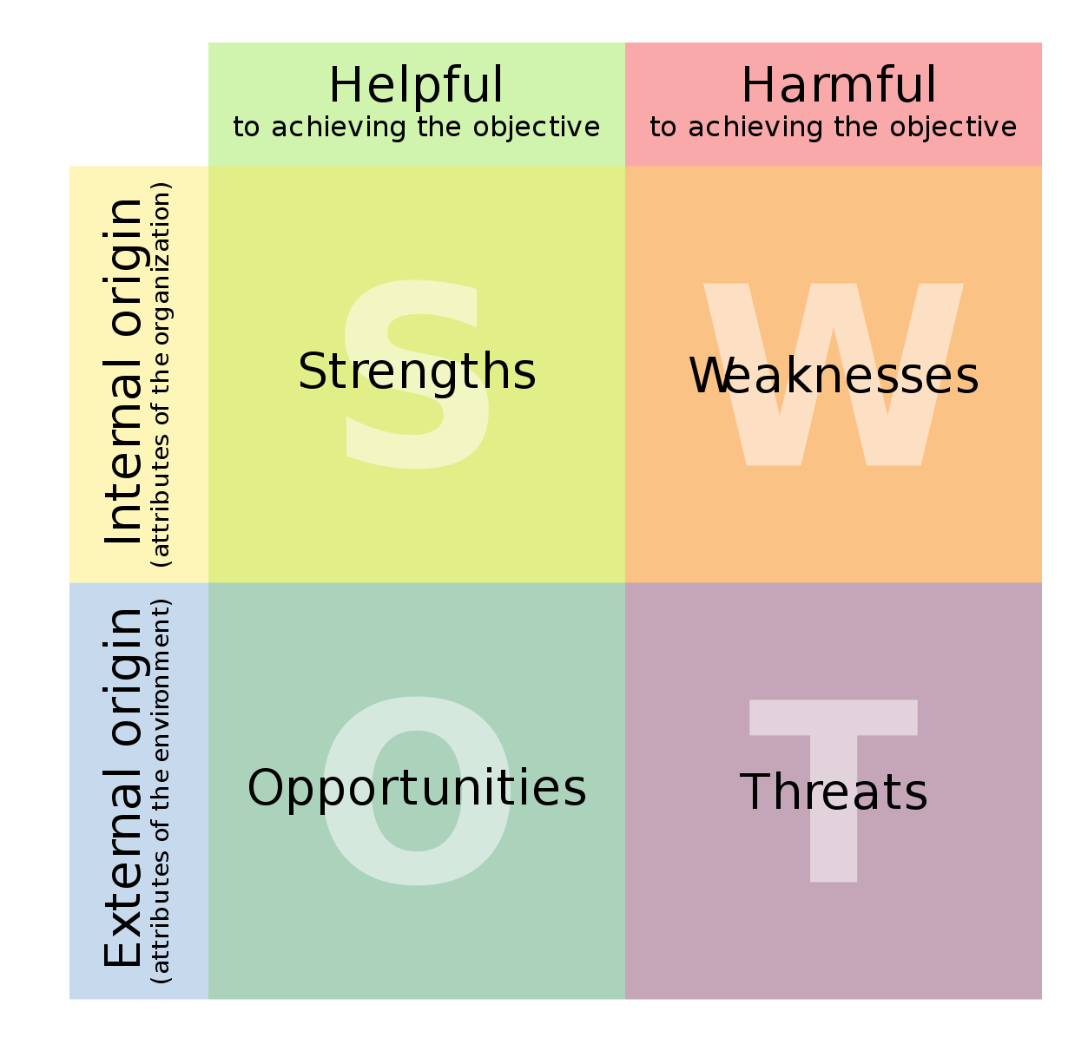
ASSIGNMENT1 SWOT analysis of Technology Enhanced Learning
We are curious to what extend you’ve already used technology to enhance your courses.
What went well? What were weaknesses?
What opportunities do you see to improve teaching and learning with the use of technology?
What might go wrong?
Assignment
We will split you up in break-out rooms. In each break-out room one of our facilitators will help you fill in a shared SWOT analyses of technology enhanced learning. In 15 minutes, we will return for a plenary recap.
Objective
To learn more on which tools might be useful in your CHARM-EU Modules and to inform each other on considerations that should be made when using technology in education.
Notes:
Vanessa introduces – Alex meanwhile puts together the break-out rooms.
Questions to ask as facilitators during the creation of the SWOT:
Have you involved your students’s needs, perspectives when choosing, using using a technology for your class?
How you can ensure student-centred approach and user-frienliness in choosing/using technology?
How you consider aims, objectives and learning outcomes regarding choosing, using your technology?

Slide 6
SWOT RECAP Plenary recap of the SWOT
Are we missing anything in our SWOT?
Tips:
It’s a good idea to make a ‘mini SWOT’ like this every time you’re considering using a new technology.
Involve students or think about a student's perspective and needs. Consider a test run with the student role!
It’s a good method to start with your aims, objectives and learning outcomes and then investigate how technology might help you reach those outcomes. Involve an expert if you’re unsure or want to brainstorm.
Notes:
[Alex shares screen of the SWOT analyses and recaps with facilitators and participants]

Slide 7
MIXED REALITY An overview and case study
Notes:
Introduction by Daniel

Slide 8
SUPPORT Support provided to tech enhance within CHARM EU
BEFORE the start of your CHARM-EU Modules
Consults with educationalist and educational technologists on your idea. Preferably do this before requesting new technology.
Practical support in setting your technology up by expert users.
Resources and use-cases on teaching tools and emerging technology.
Manuals / FAQ’s on available technology.
DURING the CHARM-EU Modules
Practical support for both teachers and students (i.e., to solve log-in problems, performance issues, other questions)
Manuals where necessary (i.e., how to use the portfolio system)
Is there any other support not listed here that you need?

Slide 9
ASSIGNMENT 2 Pitch your idea!
We are curious to see your ideas!
GOALS
To inform each other on which technologies might be useful additions to your CHARM-EU module
To inform KCT’s about other consideration when selecting tools (i.e., digital accessibility)
To help us (support) decide on what technology we might support and prepare for the CHARM-EU master’s pilot
TIMING
~3 Minutes per pitch
+ 2 minutes for questions / discussion
Notes:
*Start recording here*
What needs to be done:
Prepare a brainstorm tool (Miro) and a couple of templates that can be used to create the SWOT analyses (Vanessa?)
Based on the number of attendees decide how many break-out groups we create (Decide 1st of February)
Questions to ask as facilitators during the creation of the SWOT:
Have you involved your students’s needs, perspectives when choosing, using using a technology for your class?
How you can ensure student-centred approach and user-frienliness in choosing/using technology?
How you consider aims, objectives and learning outcomes regarding choosing, using your technology?

Slide 10
Tool choice: Strategy game
04.02.2021
Ádám Tóth, ELTE Eötvös Loránd University

Slide 11
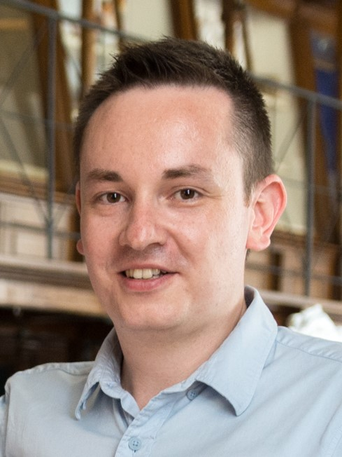
About me Ádám Tóth
Assistant professor, Faculty of Science, ELTE
Teaching:
groundwater
geophysics
geothermal energy

Slide 12
Which tool I have chosen and how I could use it in my course
Strategy game
In this computer simulation you are part of a small rural community of farmers who irrigate their land using groundwater. During the game farmers’ goal is to maximize the production of their crops. But as the game evolves, groundwater level is expected to drawdown which results in environmental consequents directly affecting the community and the players. Farmers will have to take measures to manage the common resource, get the best profit out of their crops and protect the environment and the community.
https://www.un-igrac.org/special-project/groundwater-game

Slide 13
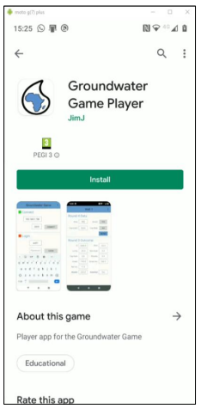
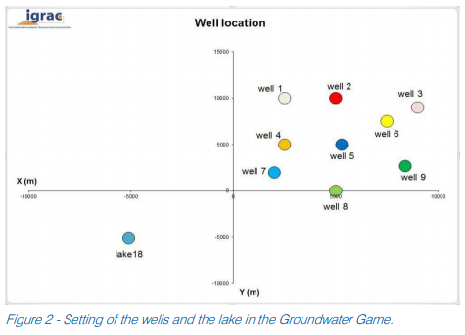
Strategy game
Which tool I have chosen and how I could use it in my course
Target audience:
water end-users
students
water authorities
water professionals
early career hydrogeologists
water sociologists and economists
NGOs
UN Agencies
WASH experts
The Groundwater Game is an excel calculations spreadsheet-based simulation managed through an app and supported with a Power Point presentation.

Slide 14
Benefits
The game consists of three different Groundwater Management Scenarios divided into eight playing rounds.
In all rounds, players have to decide on the area to crop and therefore irrigate with groundwater. In between scenarios players will have the opportunity to change their strategy by adding new features such as investment in more efficient irrigation equipment and organize together and limit groundwater abstraction among players.
Learning objectives:
The game provides opportunities to learn concepts related to groundwater use such as drawdown and depletion as well as gain insight into common pool resources, groundwater governance, groundwater management, and collective action.
improve the participants’ understanding of the functioning of groundwater systems and introduce technical concepts;
foster a deeper appreciation of the collective action choices and challenges for regulating groundwater use by influencing policies and management practices;
open up a discussion on the challenges of sustainable and equitable groundwater resources management.

Slide 15
Tool choice: Pitch2Peer
Utrecht University | Netherlands | 04.02.2021
Carole-Anne Sénit

Slide 16
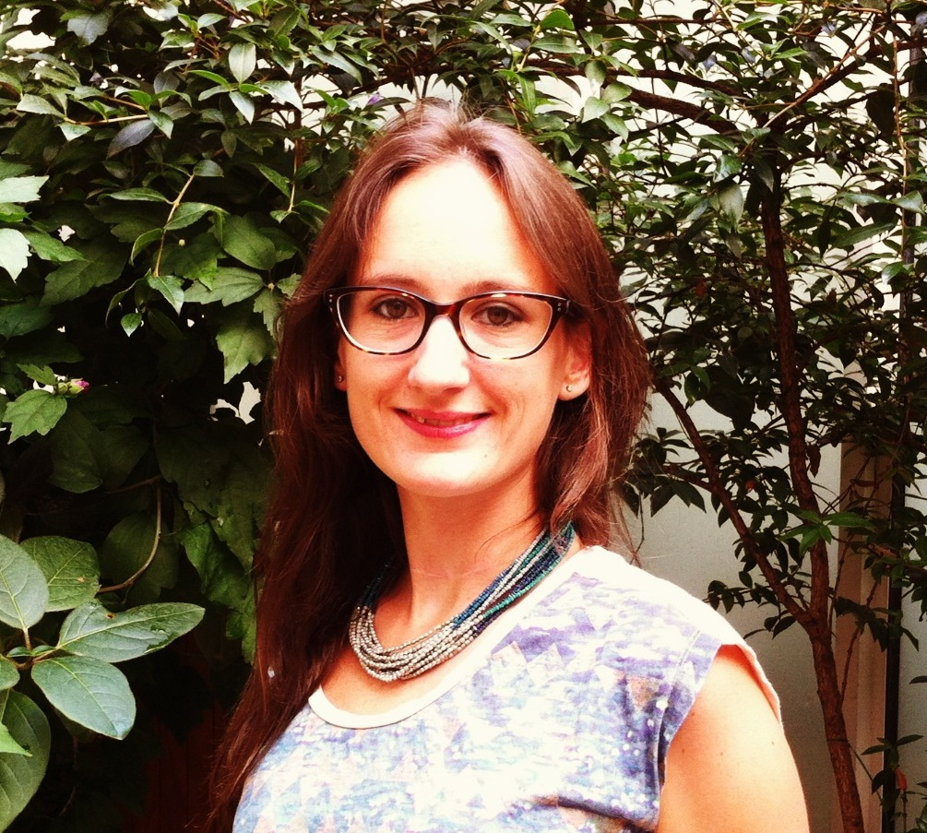
About me Carole-Anne Sénit
Post-doctoral researcher, faculty of geosciences UU
Teaching & Research:
Earth System Governance
Sustainable Development Goals
Planetary Justice

Slide 17
Selected tool for Sustainability module
The module will provide students with a solid knowledge base (conceptual, theoretical, and empirical) on sustainability and its challenges.
The module will use the SDGs as a reference framework, also to introduce the topics covered in Phase 2.
Pitch2Peer will be used to engage students in collaborative learning.
Students will be able to:
Submit their work (e.g., videos, blogs, posters, slideshows, etc.) to a digital space
Review, comment, reflect on and grade each other’s work and provide constructive feedback
Notes:
Pitch2Peer is a review tool that allows students to learn from each other’s work and feedback. Following an assignment, such as a presentation or personal research or a review of literature, students submit their ‘pitches’ to Pitch2Peer. The program supports different types of ‘pitches’, such as videos, photos, posters, slideshows, animations and (blog) texts. It is also possible to embed external media, such as YouTube or Prezi-presentations. The students can then be asked to reflect on their own work, as well as review (anonymously if necessary) one or more of their peer’s pitches. You can ask them to reflect or review with specific criteria and/or questions in mind. Also, the students can be motivated by using ‘likes’ and ‘medals’ to reward the best pitches. As an instructor you can of course also give feedback yourself.

Slide 18
How does it work?
Notes:
In the Sustainability Module, we envisage different types of assessments which could fit for the use of this tool:
Presentation (group): present and advocate for your position developed in paper 2 in a negotiation simulation exercise
Reflection video (individual): generate a 'vlog' where students present a solution that can contribute to a better world
Theoretical debate (individual): based on the required readings for each lecture, students present and discuss the main arguments of the literature

Slide 19
Benefits
The use of Pitch2Peer aims to increase community-building and peer learning.
Students learn to give and receive constructive feedback
Students interact more and that improves group dynamics
Students are challenged to convey their ideas in a clear and attractive way
Tool embedded in digital learning environments such as BlackBoard, Canvas, etc.

Slide 20
Capstone Technology enhanced learning
Marjanneke Vijge, Jake Byrne, Carole-Anne Sénit, Patricia Cucchi, Jesus Reyes, Núria Casamitjana

Slide 21
Capstone: technology needs
Collaborative space to:
Share and collaborate on documents
Develop and view different media: videos, infographics, presentations, etc.
Share databases, scientific references, etc.
Provide peer feedback on each others’ assignments
Provide 360 evaluation in anonymous manner
Develop concept maps (e.g. Miro)
Discuss and negotiate in (sub)groups

Slide 22
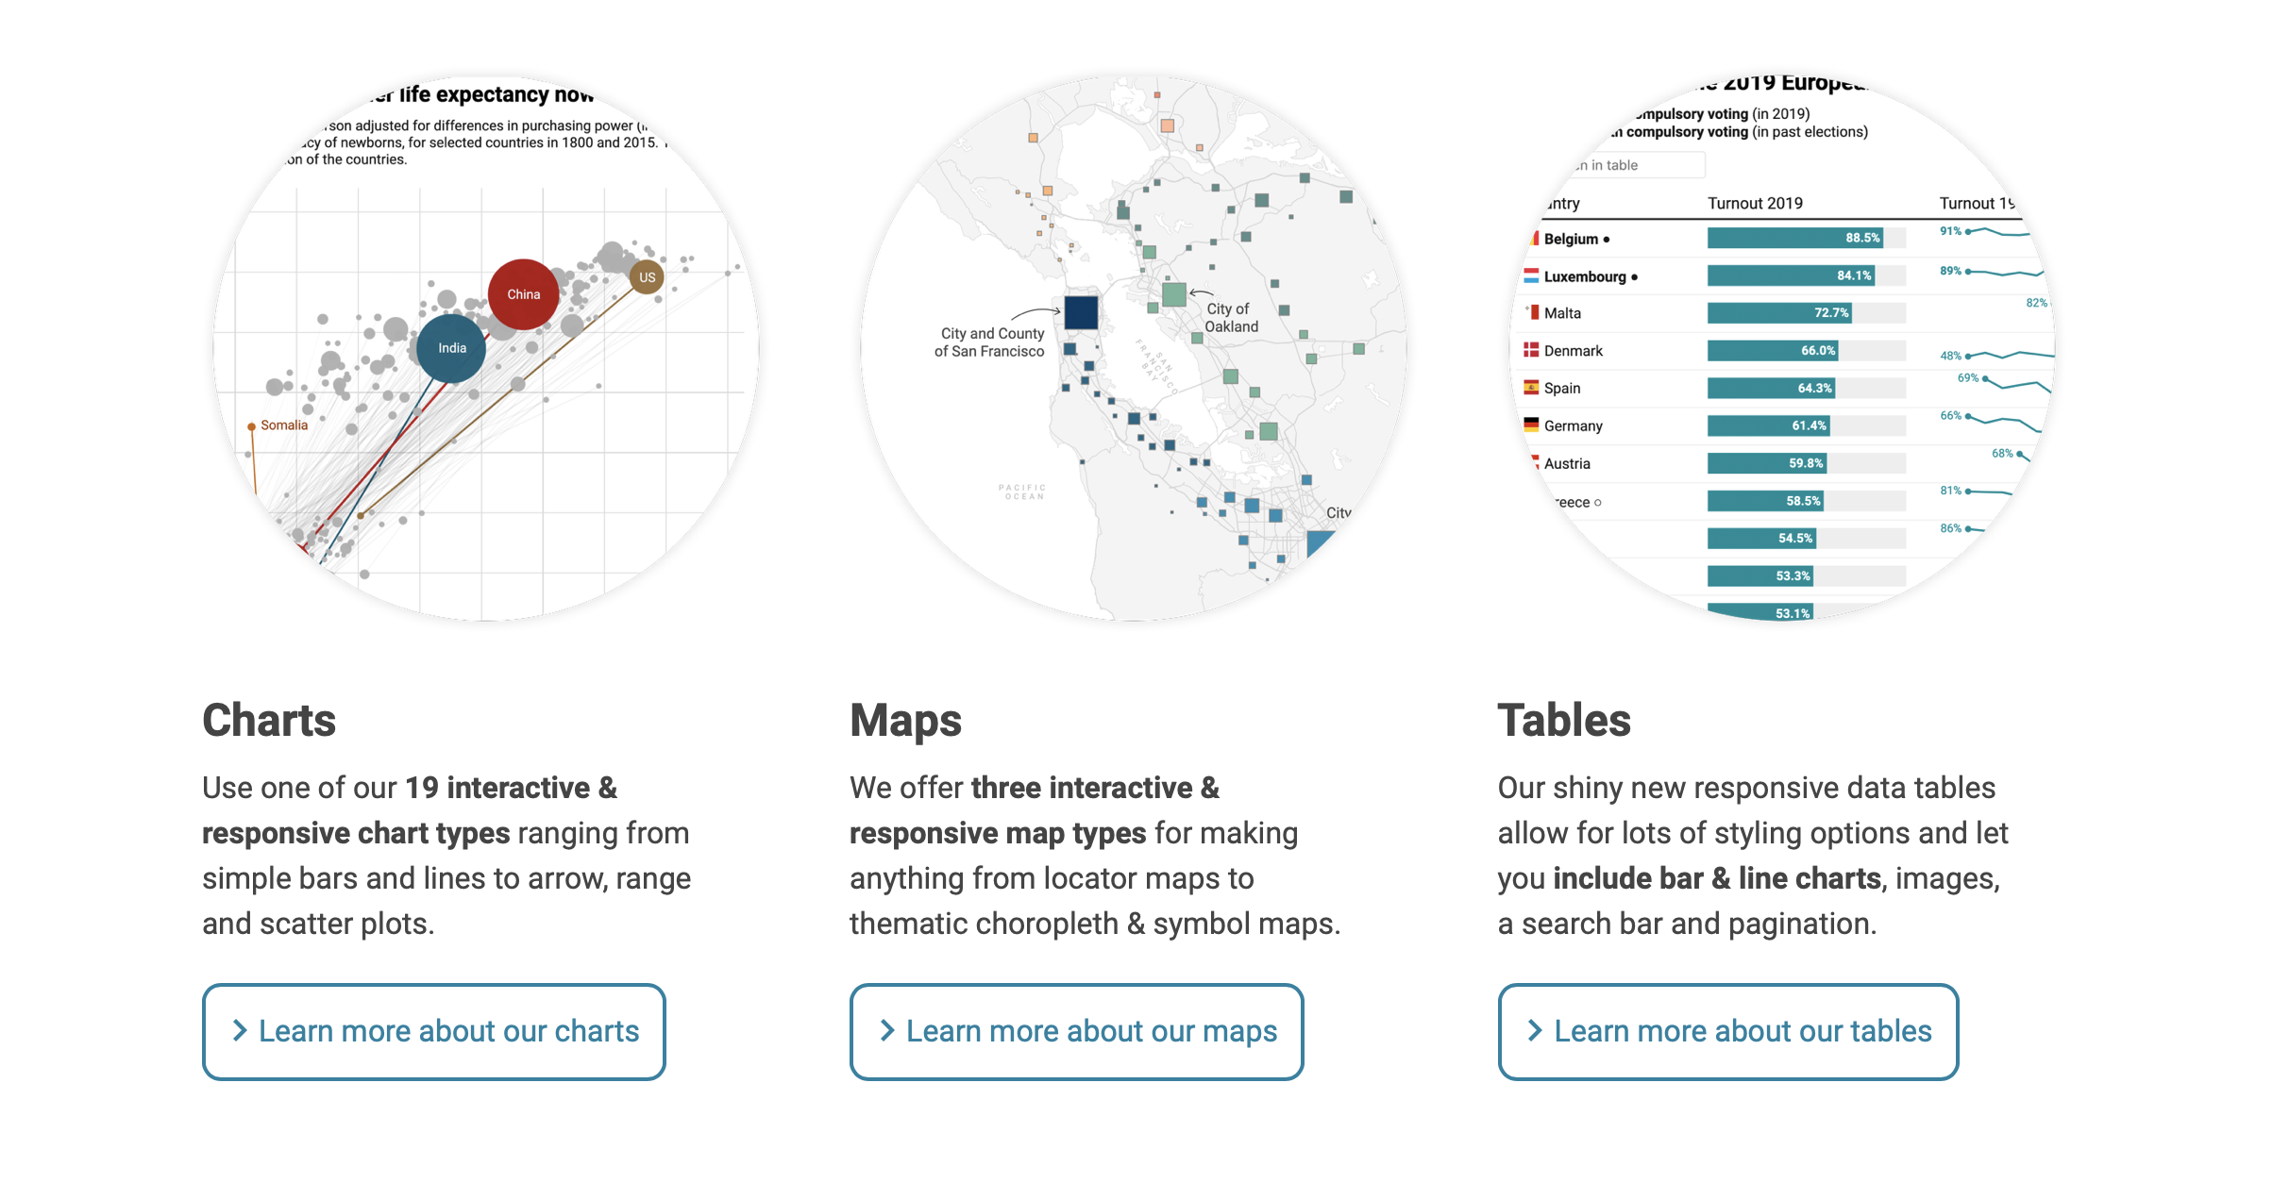
Capstone: technology needs
https://datawrapper.de
https://irelandsdg.maps.arcgis.com/apps/MapSeries/index.html?appid=3e6201e7c886420ebd6cba15671a7bdf

Slide 23
Capstone: technology needs
Developing (for students) and assessing (for teachers) portfolios
Tools to develop surveys (e.g. SurveyMonkey, LimeSurvey, etc.)
Organise online social gatherings (e.g. gamified meetings with Avatars)
Project management / planning tools
Advice/support on technology development for sustainability challenge
>> Danger of having too many platforms: how to consolidate and not make things too complicated?

Slide 24
Technology-assisted learning choices in Flexible Phase Food Theme of CHARM-EU Master Programme
Universitat de Barcelona (UB) – Université de Montpellier (UM) - ELTE – | 04.02.2021
Montserrat Camps-Gaset, Ana Moragues-Faus, Clément Bonnet, Viktor G. Mihucz

Slide 25
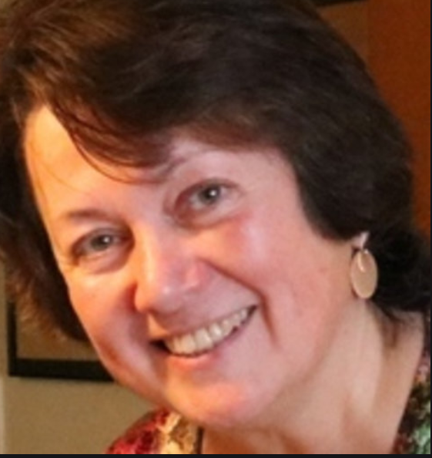
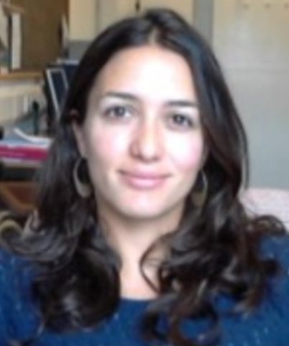
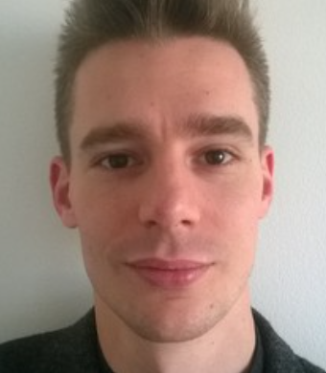
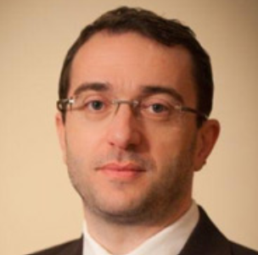
About us
Montserrat Camps-Gaset (UB) Ana Moragues-Faus (UB) Clément Bonnet (UM) Viktor G. Mihucz (ELTE)
Position | Theme Facilitator | Module 3 Coordinator: | Module 2 coordinator: | Module 1 coordinator:
CHARMEU |  | Socially Just and Sustainable Food Systems | Food systems and their transformations | The food-health-environment nexus
Home institution | Senior Lecturer | Senior Research Fellow | Associate Professor | Associate professor
Research Interests | Ancient Greek Philosophy, Mythology & Early Christianism | Political Economy | Environmental & Energy Economics | Environmental Analytical Chemistry & Food Analysis

Slide 26
About us: Teaching in CHARM-EU
Teaching type: BLENDED or HYBRID
Possible learning and assesment activities (seminars or lectures or guided work) on:
1. The discourse on food and identity, from a philosophical and historical point of view:
Defining the human identity in terms of food: the relationship of humans with the animals, the nature and the others (ideologies on vegetarianism or veganism, religious prescriptions, the taboo of cannibalism)
Defining the self in terms of food: food and spirituality, the perception of a healthy body; luxury and indulgence vs. ascetics and deprivation; body and gender (the perception of the feminine body)
2. The discourse on healthy food:
Looking beyond the words. Food and cultural tradition, food and philosophy, gender issues on food discourse.
Possible mentoring on interdisciplinary issues regarding one specific challenge:
How to connect different approaches (economic, social, historical, etc.) to one specific question.
Montserrat Camps-Gaset
(UB)

Slide 27
About us: Teaching in CHARM-EU
Teaching type: BLENDED or HYBRID
Possible learning and assesment activities (seminars or lectures or guided work) on:
Food security and sustainability
Contested discourses on food security and sustainability, how frames condition problem assessment and solutions
Understanding food security and sustainability outcomes as part of socio-ecological systems shaped by power relations, e.g. urban food environments
Critical food governance: all activities to manage, shape, steer… food system outcomes. Inclusion of all actors (public, private, social movements)
Critical perspectives that include socio-economic, cultural and political dimensions of justice when developing policies and interventions.
Design and delivery of food governance spaces but also integrated policies and interventions that address all dimensions of food security and sustainability; e.g., urban food policies
3. Action research: working with practitioners to deliver impactful actions, including assessment exercises.
Ana Moragues-Faus (UB)

Slide 28
About us: Teaching in CHARM-EU
Teaching type: BLENDED or HYBRID
Possible learning and assessment activities (seminars or lectures or guided work) on:
Environmental innovation in the agricultural sector
Conceptualization of environmental innovation
Insights for food systems
Data analysis of environmental patents
Land use conflict between energy and agricultural production
Analysis of the risks of land use conflict from the production of energy biomass
Collaborative innovation and co-design of solutions talking into account the different dimensions of land use conflicts
3. Environmental technology transfer and international negotiations
History of the co-evolution between international negotiations on technology transfer and environmental issues
Identification of the needs for international technology transfer for improving the sustainability of food systems
Clément Bonnet (UM)

Slide 29
About us: Teaching in CHARM-EU
Teaching type: BLENDED or HYBRID
Possible learning and assesment activities (seminars or lectures or guided work) on:
Food safety: Foodborne illnesses, food poisoning, allergies & carcinogens
Environmental impact of food production and dietary patterns towards ecosystem integrity under a changing climate specifically addressing
• vulnerabilities in the agriculture sector with special emphasis on its capacity changes to contribute to climate change mitigation as well as to enable food producers to adapt to new weather patterns,
• trade-off between fostering low GHG emissions (e.g. CO₂, CH₄) and ensuring that sufficient food is available for all people.
• food deterioration, storage & transport (impact of local vs. global food transport on environmental pollution), waste minimization & valorization.
Viktor G. Mihucz (ELTE)

Slide 30
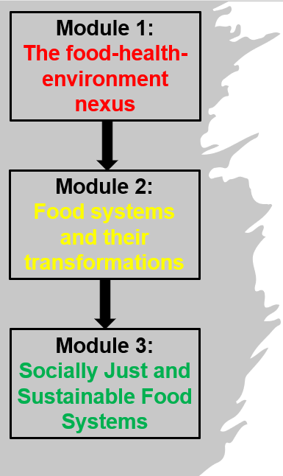
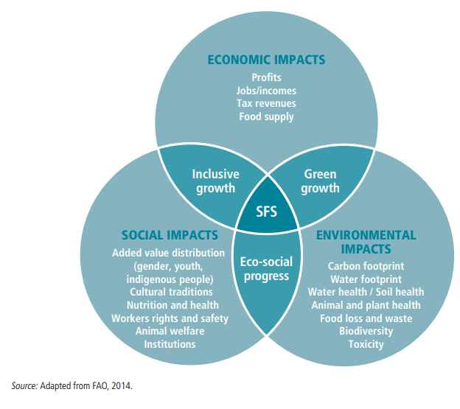
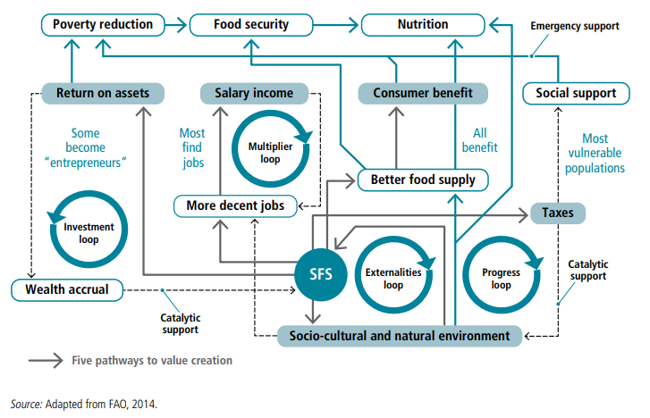
About the Food Modules: How can nutritionally and healthy food be available to everybody on the planet in a sustainable manner?
Contents
Analysis of food and its impact on human health and environment
Sustainability in food systems: position of actors & paradigms
Proposing solutions through transformations, multi-stakeholder policies, future scenarios from a transdisciplinary perspective taking into account particularities of the so-called Western and industrially developing countries.

Slide 31
About the planned teaching and assessment activities
How can nutritionally and healthy food be available to everybody on the planet in a sustainable manner?
Module Teaching type: BLENDED
Learning and assessment activities:
Simultaneous, on-line panel discussions by experts specialized in different disciplines involving extra-academic actors and students themselves
Seminars & tutorials
Quiz (single choice, multiple choice, Q&A)
Essay writing (individual & team work)
Student workshop: pitch & presentations

Slide 32
Tools proposed technological tools for course teaching and assessment
Technological tool | Learning activity | Benefits | Availability
Wooclap & Wooclap/ Powerpoint connected to overhead projector, students’ smartphones | Adding questions in real time on the panel discussions | To engage students and maintain their attention on the topic & feedback for lecturers | NO
Zoom Professional Whiteboard/Digital Pen tablet | Panel discussions, Student presentations | To facilitate learning | n.a.
Zoom Professional breakout rooms | Panel discussions | To promote brainstorming among students on small tasks in smaller groups | n.a.
Moodle and/or Exam.net | Panel discussions, seminars, tutorials | To share 1) slides of the presentations and whiteboard content & 2) supporting materials facilitating learning 3) programmed MCQ, SC, Q&A test writing | n.a.
Teams Groups | Essay writing | To develop transversal skills of students by performing joint assignments | YES
Other (smartphone) applications: e.g., Mural/Fit4Food, Basecamp, FoodMapping, Games4Sustainability | Collaborative learning and construction of ideas | To improve communication capability of students: recognize social inequities concerning food production as part of their written/oral productions | NO

Slide 33
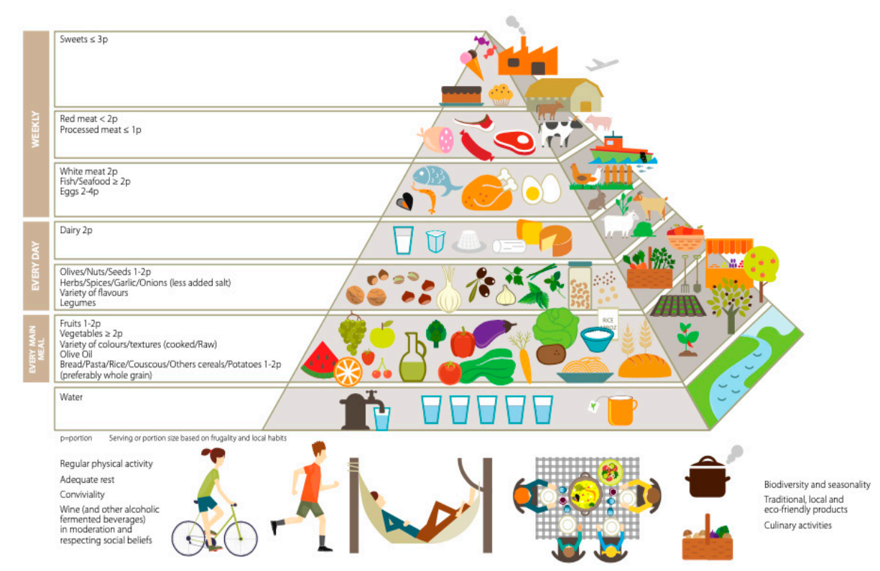
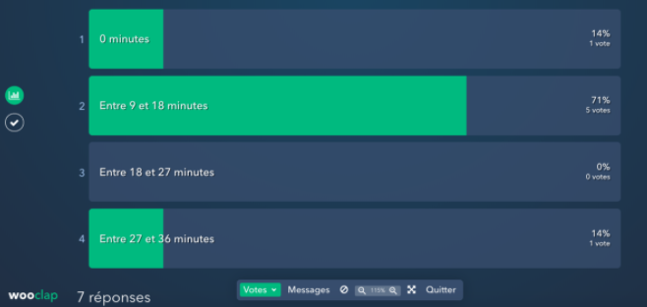
Examples 1.
Workshop presentation topics:
1. Cocoa as food item: health and cultural benefits.
2. Cocoa as part of the food system: How can cocoa be produced in sustainable way?
Collaborative essay writing on Teams on the topic:
How does industrial food production and Big Food Corporations influence diet-related chronic conditions (obesity, diabetes, cholesterol);
Question for feedback by using Wooclap (see also slide):
What is the novelty in the updated Mediterranean diet?
Preference for local, seasonal, fresh food
Preference for minimally processed food
Environmental impact of the food items
Aspects of food production sustainability
Answers recorded on Wooclap and
instant display during the lecture

Slide 34
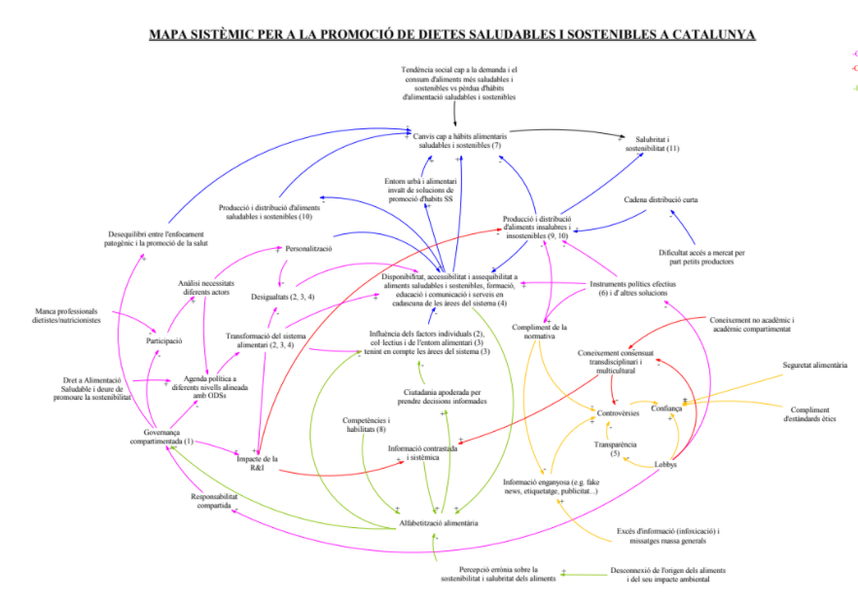
Examples 2 – Module 3.
Collaborative learning and construction of ideas (e.g., tool Mural used in the Fit4Food Barcelona Living Lab)
Systematic Map for the promotion of sustainable healthy diet in Catalonia

Slide 35
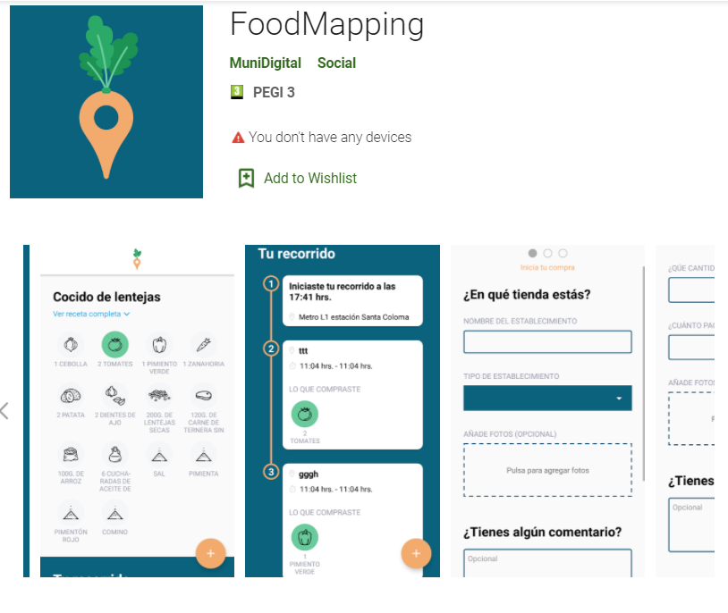
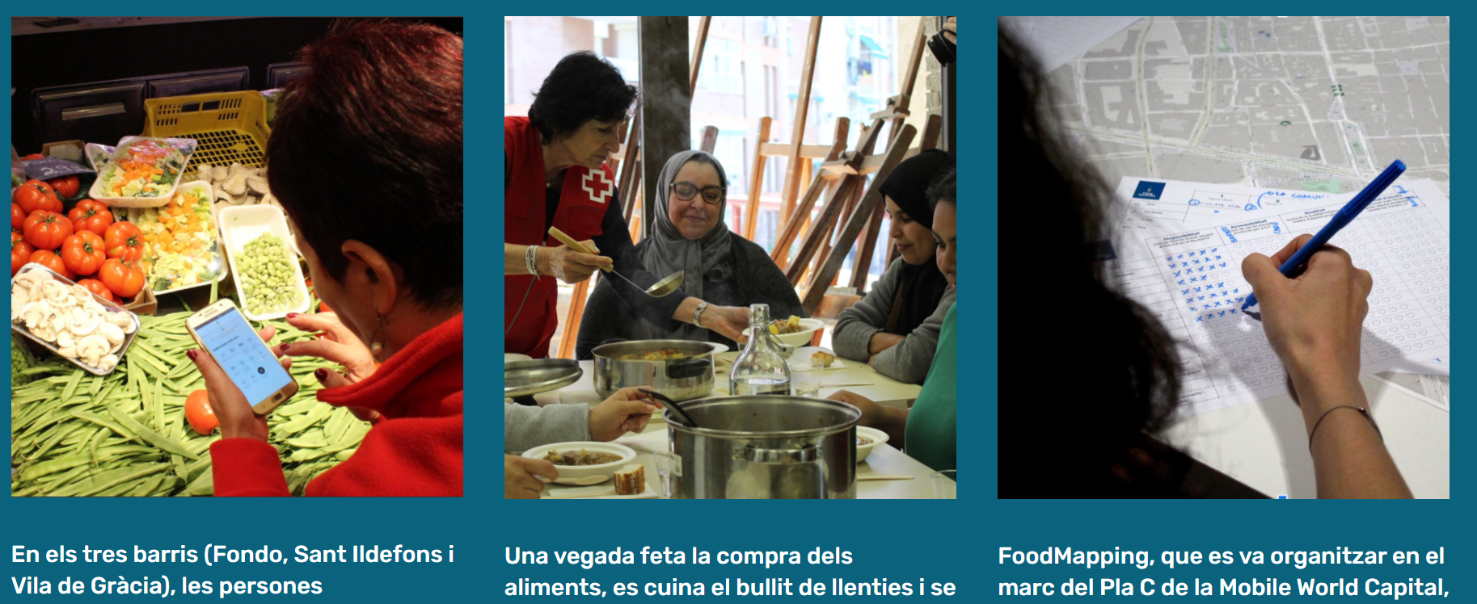
Examples 3. – Module 3
Use of interactive apps to map food environments and report experiences for example through photovoice.
Also the Sustainability game could be adapted and be useful

Slide 36
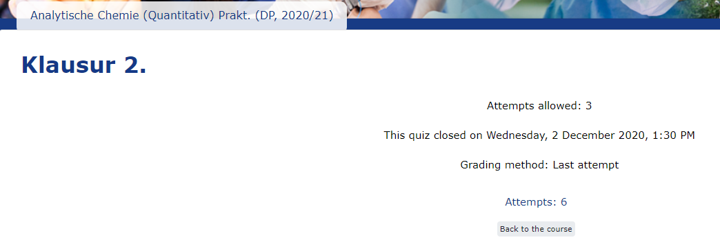
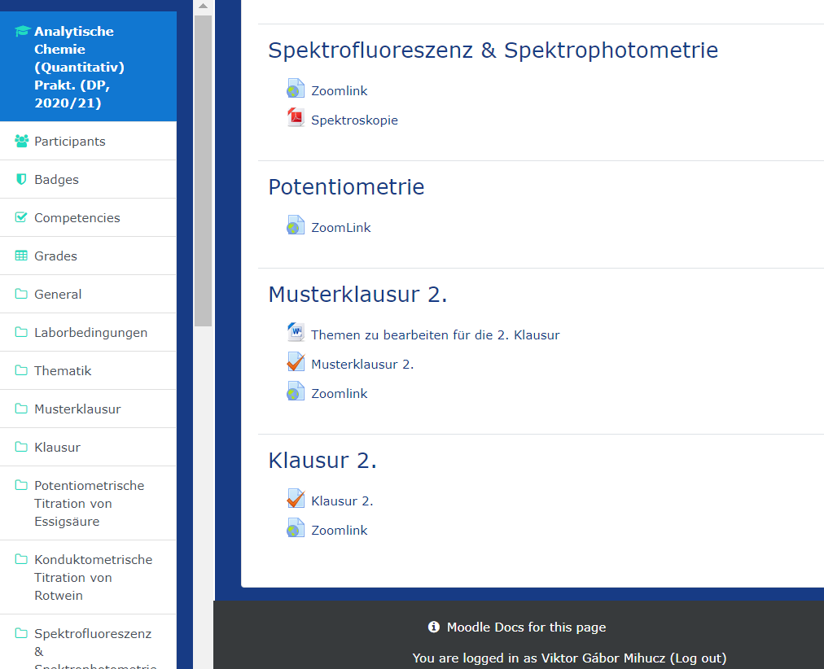
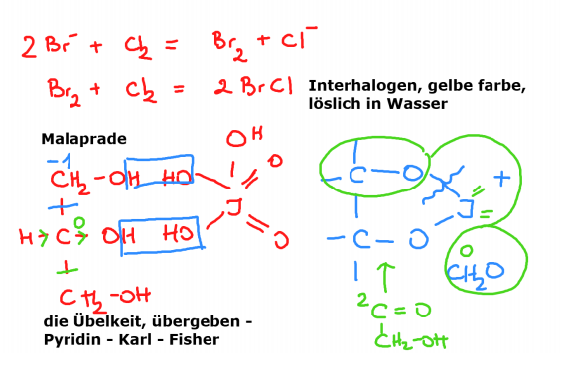
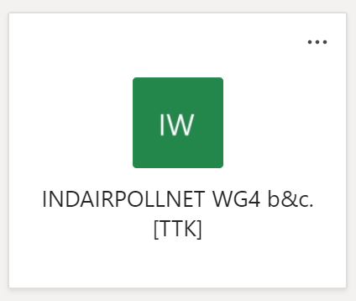
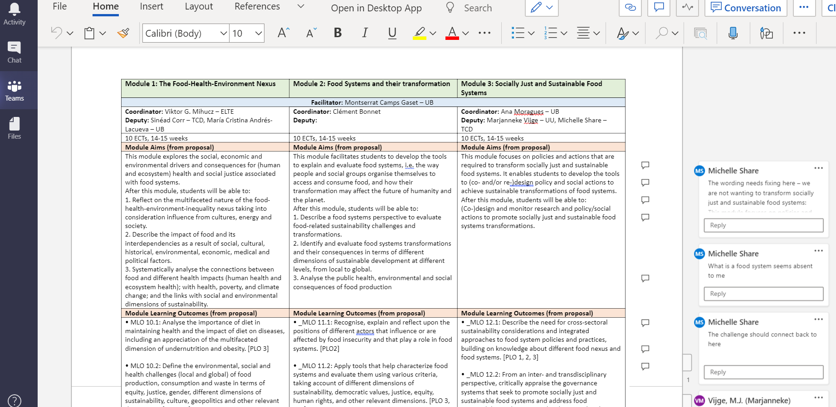
Examples 4. – Basic tools
Programmed Midterm Test on Moodle
Saved explanation written on ZOOM Whiteboard
Editing a draft on Teams
Slides and video recordings of ZOOM lectures
posted on MOODLE

Slide 39
Tool choice: Virtual Reality
Trinity College | Ireland and 03.02.2021
Jake Rowan Byrne

Slide 40
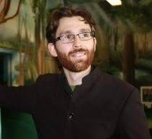
About me Jake Rowan Byrne
Assistant professor, School of Education TCD
Teaching:
Contemporary Teaching and Learning Practices
Introduction to Programming (Software and Hardware)
Creativity, Design Thinking and Innovation
Transdisciplinarity

Slide 41
Which tool I have chosen and how I could use it in my course
Students will develop an advanced understanding of transdisciplinarity to enable them to work in a transdisciplinary/multidisciplinary/ interisciplinary teams. They will be able to demonstrate a critical appreciation of the challenges of integrating different disciplinary and transdisciplinary approaches and research methodologies.
I’ll like to use Virtual Reality to engage students and help them explore diverse perspectives.
I’ll like to engage students by:
Having them experience diverse perspectives through immersive VR experiences.
Having them reflect on these experiences
Having them empathise with a diverse set of stakeholders.

Slide 42
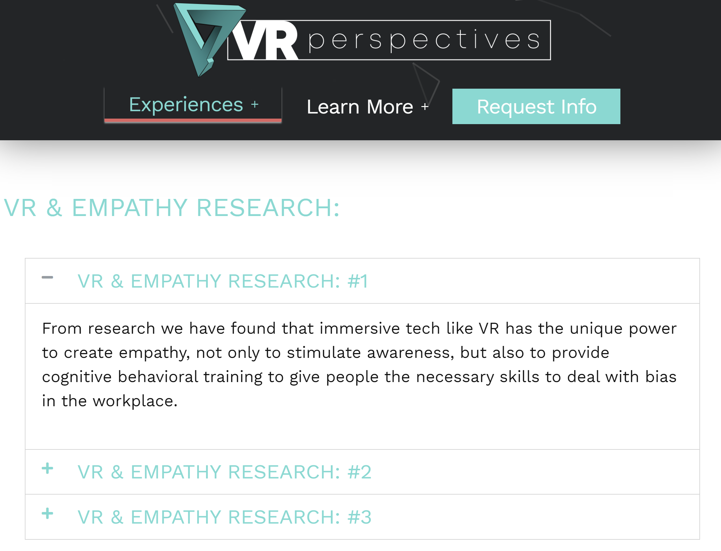
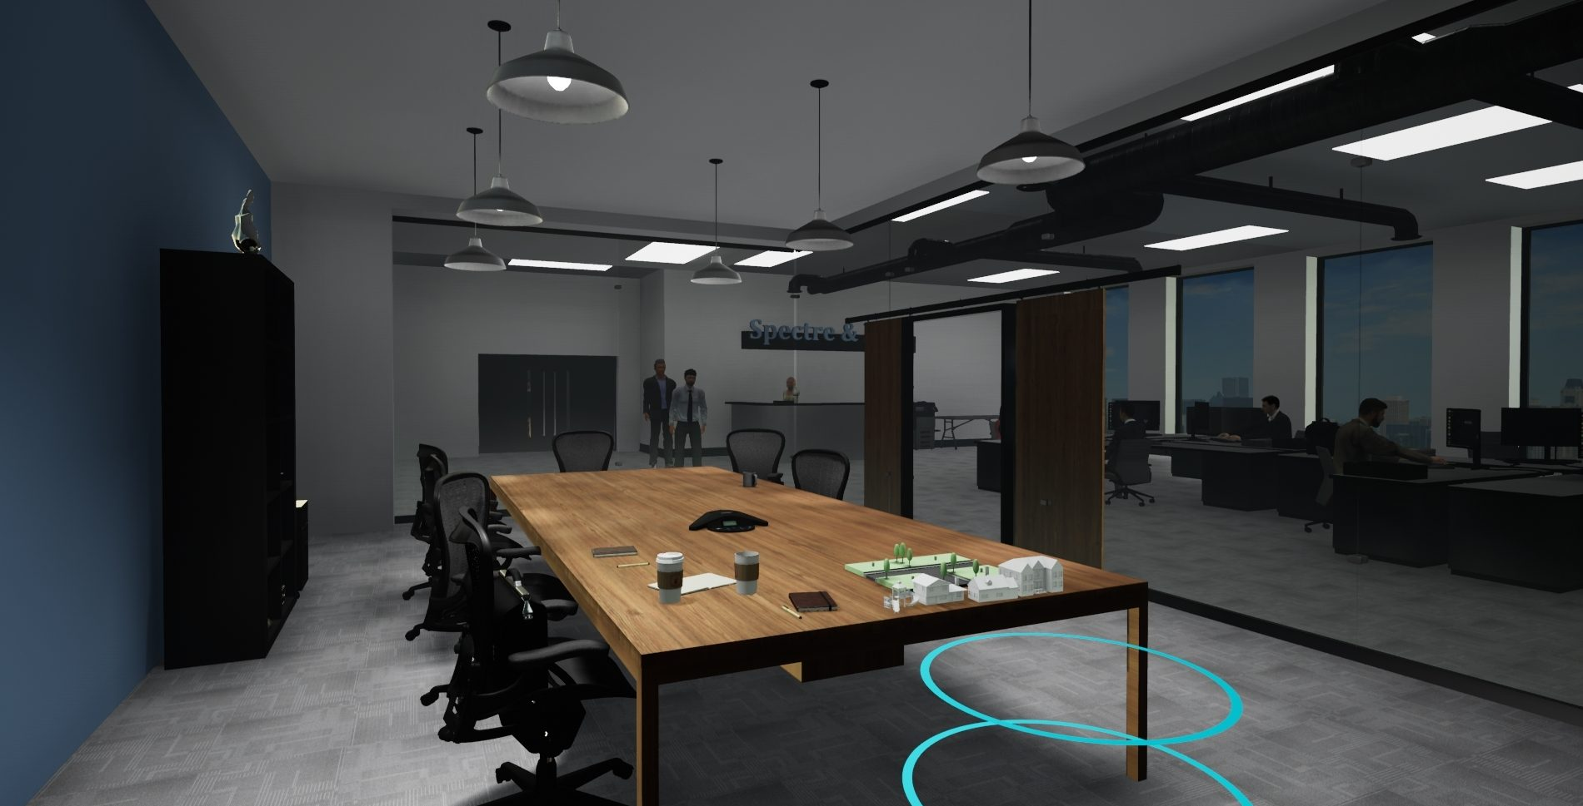
Examples
VR Perspectives

Slide 43
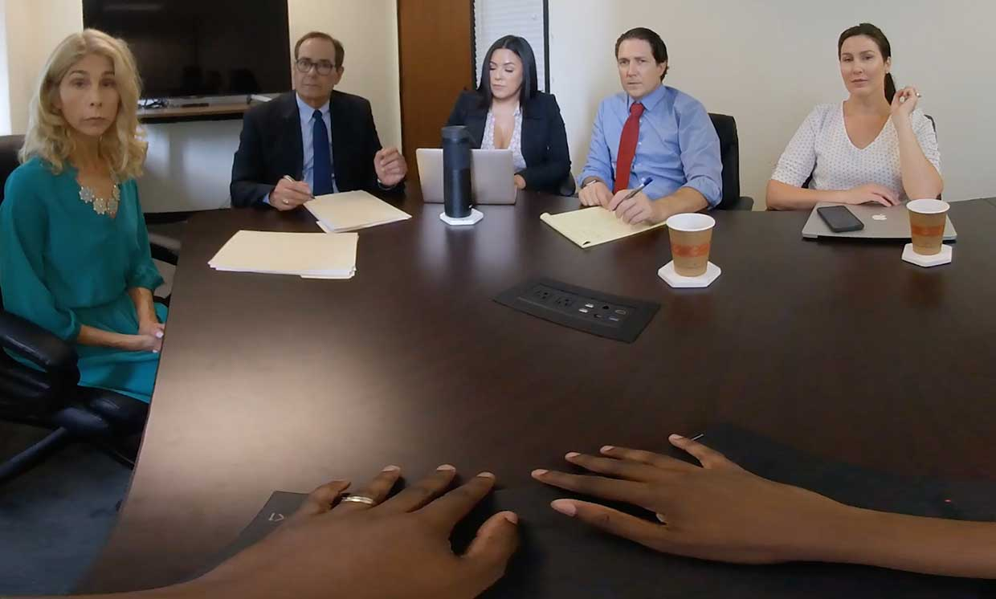
Examples
Live in their World

Slide 44
Benefits
The use of VR during this module has the goal of offering student the opportunity to explore diverse perspectives and their own unconscious biases.
Students will be aware of their own biases
Students can recognise gender inequities in their the impact of multiple and diverse perspectives
Students reflect and address bias and multiple perspectives in their research and projects

Slide 46
REQUEST How to make a TEL request
How to request new technology?
Involve us as soon as possible – contact information will be sent to you after this workshop
We will provide and prepare basic teaching tools for you like:
Moodle to organize your module
Teams for collaboration and communication
E-portfolio software for programmatic assessment
WooClap for voting / interactive presentations
Notes:
*INFORM THAT WE WOULD LIKE TO RECORD THIS PART FOR SHARING WITH OTHER CHARM-EU MEMBERS*

Slide 47
REQUEST Considerations to be made
CHARM-EU Core requirements for technology enhanced learning:
Sustainable
Secure
Privacy compliant
We value open source if available
User-friendly
Digitally accessible and inclusive
Affordable in time and money
We will support you with this and unburden you, but we need time to investigate whether your requested tool meets these requirements.
Notes:
Alex briefly explains the core requirements and explains that we don’t want participants to worry much about this but instead involve us as soon as possible so they can focus on module design.

Slide 48
DIGITAL ACCESSIBILITY Questions for you!
WHAT DOES DIGITAL ACCESSIBILITY
MEAN TO YOU?
Question Description: Share your own interpretation, understanding
WHAT DO YOU NEED
TO TAKE THE LEAP TOWARDS DESIGNING INCLUSIVE FOR PEOPLE IN ALL THEIR DIVERSITY?
Question Description:
What support do you need for designing the teaching & learning environment to be more inclusive?
Credit: https://www.ded4inclusion.com/uploads/4/7/7/8/47789531/b1cover_orig.jpg
Notes:
@Ágnes this seems like a great outline to me. Maybe finish is with info on who to contact with questions when in doubt? We could also include that in the e-mail / documents we will send to the participants after the workshop is finished.

Slide 49
DIGITAL ACCESSIBILITY Questions for you!
Ladies and gentlemen back to wooclap please!
Notes:
@Ágnes this seems like a great outline to me. Maybe finish is with info on who to contact with questions when in doubt? We could also include that in the e-mail / documents we will send to the participants after the workshop is finished.

Slide 50
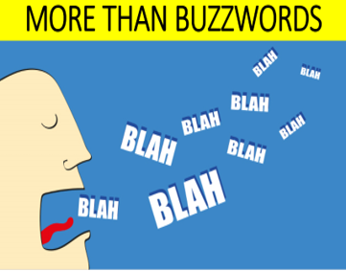
DIGITAL ACCESSIBILITY What and why
WHAT DOES IT MEAN?
“Digital accessibility is the process of making digital content and services accessible to everyone. It is about providing all users equal access to the same information [...].” (World Wide Web Consortium (W3C))
WHY DOES DIGITAL ACCESSIBILITY MATTER?
Access and inclusion should not be based on a philanthropic approach, but rather on alignment with basic human rights.
Universality needs to be taken seriously.
Providing accessibility in digital products that is that everyone can perceive, navigate, interact with your product.
Credit: https://image.shutterstock.com/image-vector/caricature-mans-head-his-mouth-600w-415924102.jpg
Notes:
@Ágnes this seems like a great outline to me. Maybe finish is with info on who to contact with questions when in doubt? We could also include that in the e-mail / documents we will send to the participants after the workshop is finished.

Slide 51
DIGITAL ACCESSIBILITY Perceptions, misconceptions
[...] Accessibility kills creativity, it really does not […]
It is actually a creative challenge
Accessibility is difficult. Accessibility is not difficult
it is just unfamiliar territory for a lot of us
The only thing, which keeps it unfamiliar,
is the way we think about it,
accessibility is in many senses just about understanding"
(Watson, 2013) W3Conf 2013
Credit: https://imsts.com/sites/default/files/styles/image_1200x550/public/2018-06/blog-ims-perception-reality_1.jpg?itok=gNnJ3ujm
Notes:
@Ágnes this seems like a great outline to me. Maybe finish is with info on who to contact with questions when in doubt? We could also include that in the e-mail / documents we will send to the participants after the workshop is finished.

Slide 52
DIGITAL ACCESSIBILITY TOP 10 C's TIPS :)
1. CATER THE NEEDS OF YOUR USERS
meet the needs the greatest extent of your adience: needs assessment
2. CONSIDER YOUR DESIGN APPROACH
"DESIGN LIKE YOU GIVE A DAMN" Leonie Watson WC3 Conference 2013
3. CHECK PRODUCTS ACCESSIBILITY POLICIES
some emerging technologies create barriers in accessing information
4. CREATE INCLUSIVE LEARNING&TEACHING SPACE
Blackboard Ally is excellent
5. CHECK-IN OFTEN
test often, fix little, spend less
6. COMPREHEND - UNIVERSAL DESIGN OF ICT:
A historical journey from specialized adaptations towards designing for diversity
7. CONTENT
Universal design makes your content inclusive to all without segregating or stigmatizing. It provides a single message, not separate messages identifying certain target groups.
8. CONSULT
Learn about research hubs, networks, such as: Universal Design of ICT (UD-ICT)
9. COURAGEOUS
Think outside of the box, like there is no box there – do not settle with the familiar solutions
10. CULTURE CHANGER
Be the pioneer, start the step-by-step journey of inclusion
Notes:
@Ágnes this seems like a great outline to me. Maybe finish is with info on who to contact with questions when in doubt? We could also include that in the e-mail / documents we will send to the participants after the workshop is finished.

Slide 53
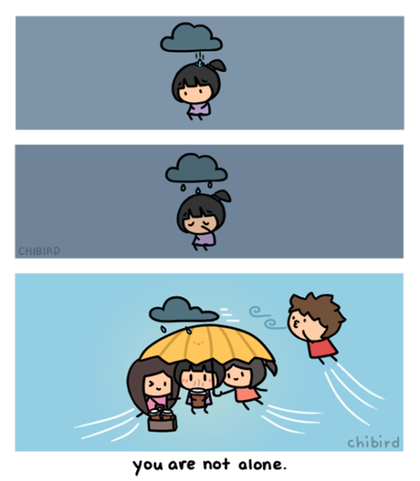
DIGITAL ACCESSIBILITY You are not alone, we are here to support you :)
For any digital inclusion, accessibility questions, requests ​do not hesitate to contact us at charmeuwp6@elte.hu
Credit: https://chibird.com/post/181963063703/reminder-you-are-not-alone-you-have-people-out
Credit: https://www.facebook.com/buddybenchireland/photos/a.787924524649928/3193758157399874/?type=3
Notes:
@Ágnes this seems like a great outline to me. Maybe finish is with info on who to contact with questions when in doubt? We could also include that in the e-mail / documents we will send to the participants after the workshop is finished.

Slide 54
Notes:
Closing – Thank everyone and inform them about the possibility to apply for a 30 min consultation with an expert on TEL. (If time allows it, any last questions / comments?)
Inform them that they’ll receive a follow-up / recap with all the information through e-mail.

